Slide 1

By Their Fruits Foundation
You will know them by their fruits Matthew 7:16-20

Slide 2

Overview
Who We are & What We Do | 501(c)(3) non-profit organization
Our Product | What it is
Our Packaging Events | The magic behind our product
Fundraisers & Charitable Affairs | Events hosted throughout the year
The Impact of Your Donation | Expand our outreach
Q&A Session | Questions from audience

Slide 3
Who We Are & What We Do
“We are committed to carrying a message of hope and simultaneously motivating as many people as possible to show solidarity towards the most needy people in our society. We aim to unite different communities through our products and events to achieve a common good.”

Slide 4

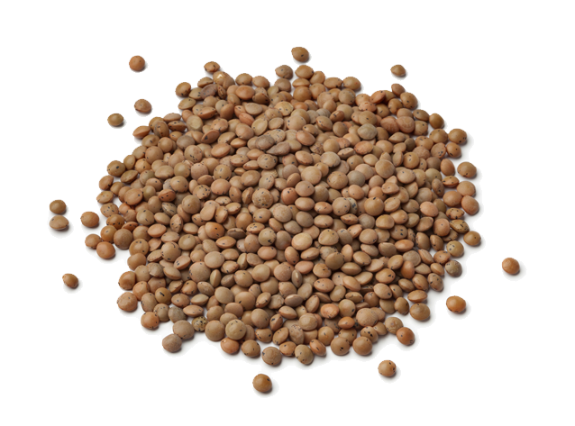

Our Product
Our packaged meals contain:
1 cup of lentils
1 ½ cups of rice
1 teaspoon of salt
X cals per package
Each package feeds x people
Notes:
Each bag takes 10-12 minutes to cook when mixed in with water and feeds around X people per bag.
The prepackaged meals consist of 1 and 1/2 cups of rice, 1 cup of lentils, and one of salt.

Slide 5
Our Packaging Events
Assembly line: 15-16 stations
3-4 volunteers in each “packaging” station.
3-5 “Runners” -volunteers who collect the packages in baskets to transport them to the next station
10-12 volunteers in the “sealing station,” where a hot seal is used for each packaged bag
After that, they are placed into boxes placed in palates and into trucks.
From the trucks, they go into containers and are shipped.
Partnerships with local foundations and churches that create a bridge ensuring impoverished communities receive the boxes

Slide 6
Our Packaging events
Foundation hosts the event, usually 8 am- 12 pm on a Saturday
Occurs 1-2 times per month, depending on supplies
Volunteers are given hair caps, gloves, and a lanyard upon arrival.
Boxing Station
Packaging Station
Shipping
Sticker Station
Sealing Station
2
4
1
3
5
Notes:
From a bird-view perspective, the foundation hosts the event, usually 8 am- 12 pm on a Saturday, and occurs 1-2 times per month, depending on supplies. Volunteers are given hair caps, gloves, and a lanyard upon arrival. All volunteers are assigned a lanyard that specifies their role for the duration of the event. The event organizers are flexible for those with a position of preference. Still, overall, the distribution of functions is the following: Seniors are usually assigned the “packaging” or “sticker labeling stations” because these are seated stations. Adult women and teenagers are spread throughout all stations, but mainly, “packaging” stations are standing, and “sealing” stations are seated. Adult men and teenagers are usually at the “boxing station,” where the sealed packages are placed in palettes and into a truck, or “suppliers,” which replenish the lentils, rice, and salt at all the “packaging” stations. Lastly, children are the designated “runners” who can (a) grab the baskets with the filled packages from the packing stations and transport them over to the sealing station where the packages are sealed. (b) take the empty bags with stickers to the “packaging” stations where they will be filled. All events have a designated break area, where snacks, seating, and water are provided. No eating is allowed in the packaging area.
If we zoom in on the perspective of the journey of a single-meal bag, it is the following: The bag starts with the sticker station: 8-10 people put stickers on the acetate transparent bags. The bag gets placed in a box and distributed among the packaging stations. Packaging station: In this Station, the rice, lentils, and salt are added to the bag. After that, the bags get taken to the Sealing Station to be sealed and passed on to the Boxing Station, and there are 52 meal bags placed per box. The finalized boxes are shipped by sea to the designated countries; upon arrival, they spend some time in customs and then head to their city of destination.

Slide 7
Who do We Help?
North/Central America
Mexico
El Salvador
Caribbean
Dominican Republic
Puerto Rico
Haiti
South America
Colombia
Venezuela
Notes:
Once the box reaches the community, most of the bags are handed out to the families to take home, and a few are mixed in together for a community cookout because some people don’t have electricity to cook it in their homes.

Slide 8


Fundraisers & Charitable Affairs
Family Virtual Bingo
Annual Gala

Slide 9
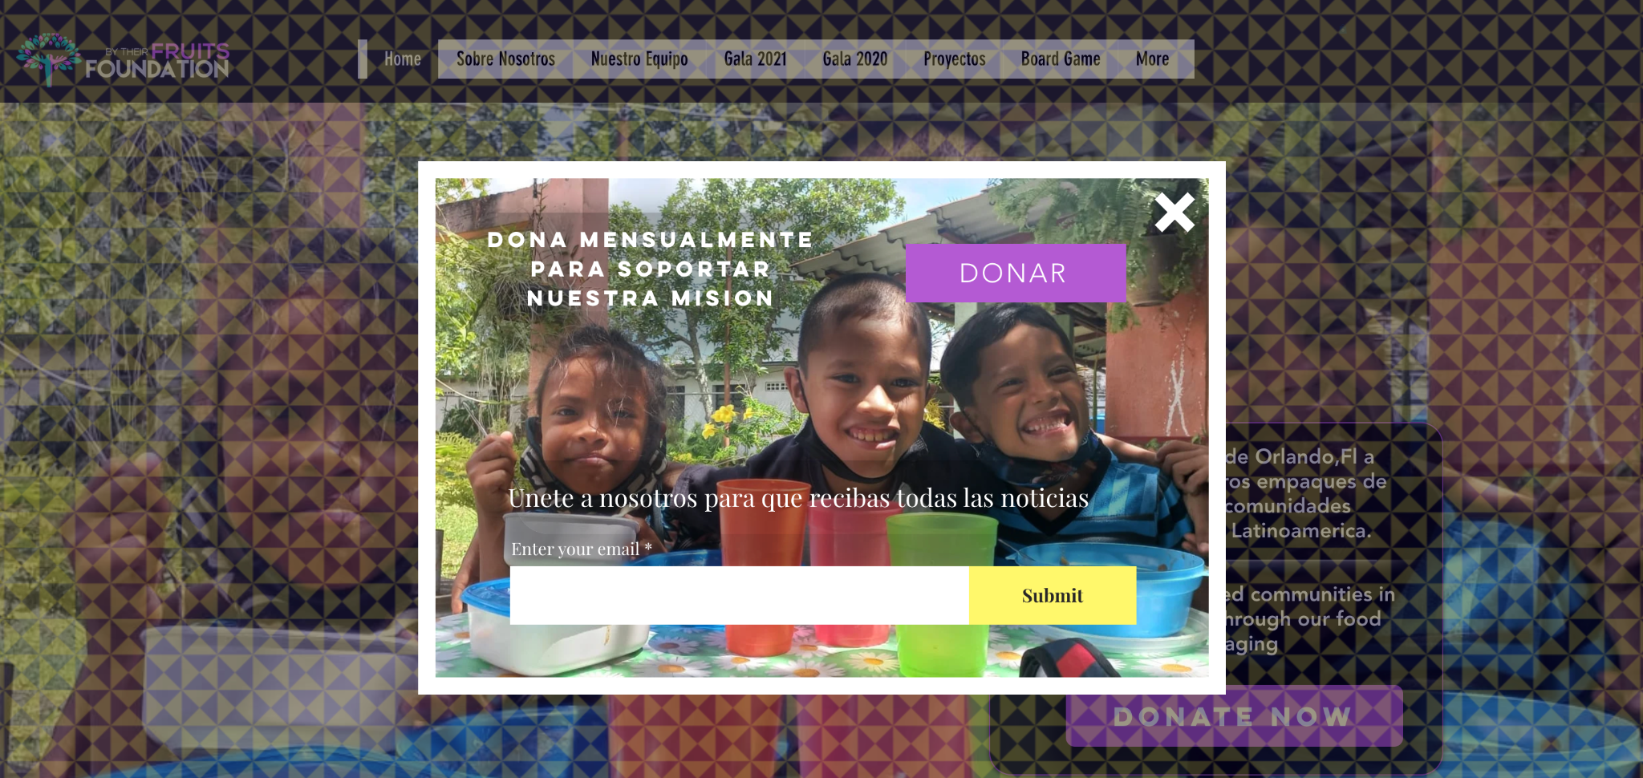
Our Social Media
Instagram: @By_theirfruits
Facebook: @Bytheirfruits
Website: https://www.bytheirfruitsfoundation.org/

Slide 10
The Impact of your Donation
By supporting By Their Fruits, your organization has the opportunity to be a catalyst for meaningful transformation. Together, we can create a ripple effect that extends far beyond the confines of this partnership, leaving a legacy of empowerment, innovation, and compassion to those who live in poverty
Notes:
In conclusion, we are excited about the prospect of partnering with your organization to make a lasting impact through our shared commitment to [the cause or mission of your nonprofit]. Your potential contribution is not just a financial investment; it is an investment in positive change, social responsibility, and the betterment of our communities.
By supporting By Their Fruits, your organization has the opportunity to be a catalyst for meaningful transformation. Together, we can create a ripple effect that extends far beyond the confines of this partnership, leaving a legacy of empowerment, innovation, and compassion to those who live in poverty
As we move forward, we are eager to discuss any questions or concerns you may have and explore the various ways in which we can tailor this collaboration to align seamlessly with your companies values and objectives. Your involvement will not only contribute to the success of our programs but will also position your organization as a key driver of positive change in our community.

Slide 11
Thank You!
Notes:
Any Questions

